Slide 1
GEOG-G489/589 Python Programming
Instructor: Natasha MacBean
Introduction to Python’s NetCDF4 library and missing values with NumPy masked array

Slide 2
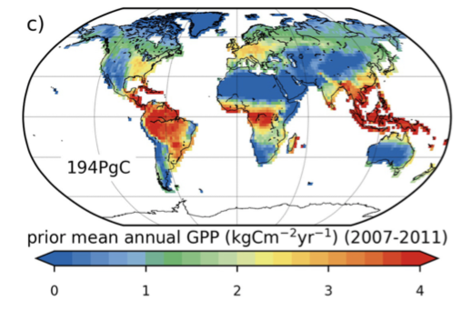
Data in today’s class: modeled global gross C uptake (GPP)
GPP: gross primary productivity - the gross uptake of CO2 by terrestrial plants during photosynthesis
Simulated by the ORCHIDEE land surface model (forms part of a French earth system model used to make IPCC climate change projections): https://orchidee.ipsl.fr
Monthly simulations from 2007 – 2011
MacBean, N. et al. (2018), Strong constraint on modelled global carbon uptake using solar-induced chlorophyll fluorescence data, Scientific Reports, 8, 1973: https://macbeanlab.com/publications/

Slide 3
Today’s class: netCDF files and NumPy masked arrays
Netcdf is a file format that supports large geospatial array-like (i.e. gridded) data (find out more here: https://www.unidata.ucar.edu/software/netcdf/docs/ ).
It is a commonly used format for i) global climate reanalyses (https://en.wikipedia.org/wiki/Meteorological_reanalysis ), ii) for climate/earth system model outputs, and iii) for remote sensing products.
We will also learn about using NumPy's masked array functions to mask out missing values in numerical arrays.

Slide 4
netCDF files
NetCDF files are not the type of file you can just open in a text file to have a look at. Therefore, how do we know which variables are stored in the files and what the names of those variables are?
One way is to download Panoply, which is a netcdf, HDF5 and GRIB data viewer here: https://www.giss.nasa.gov/tools/panoply/download/

Slide 5
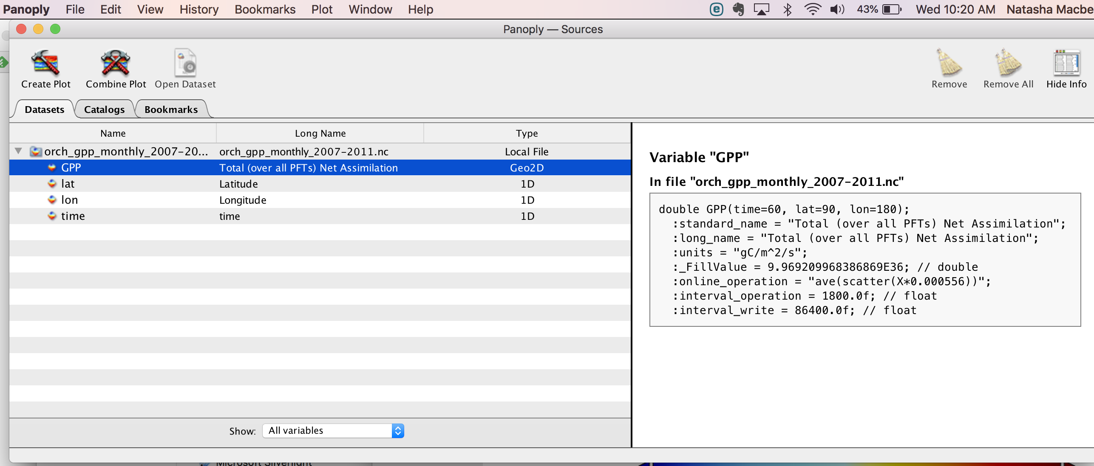
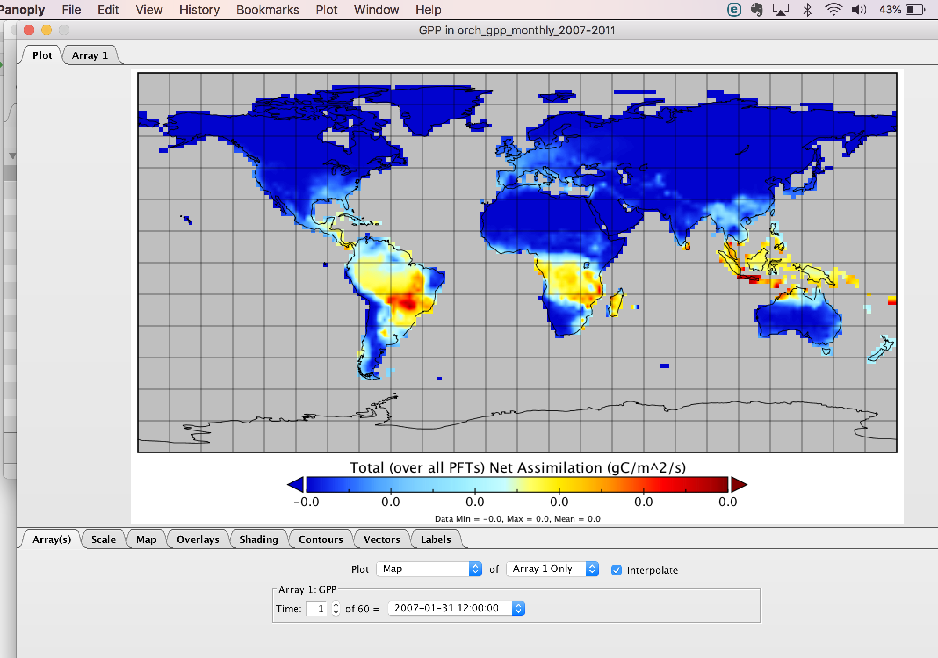
netCDF files: panoply

Slide 6
netCDF files
NetCDF files are not the type of file you can just open in a text file to have a look at. Therefore, how do we know which variables are stored in the files and what the names of those variables are?
One way is to download Panoply, which is a netcdf, HDF5 and GRIB data viewer here: https://www.giss.nasa.gov/tools/panoply/download/
Alternatively, there are a number of ways you can work with netcdf files using the unix terminal command line: https://www.unidata.ucar.edu/software/netcdf/docs/netcdf_working_with_netcdf_files.html .
In particular, ncdump will output ("dump") the contents of your netcdf file to the command line.
The first lines represent the "header" of the file, i.e. which variables are contained the file with their dimensions and attribute (metadata) information.

Slide 7
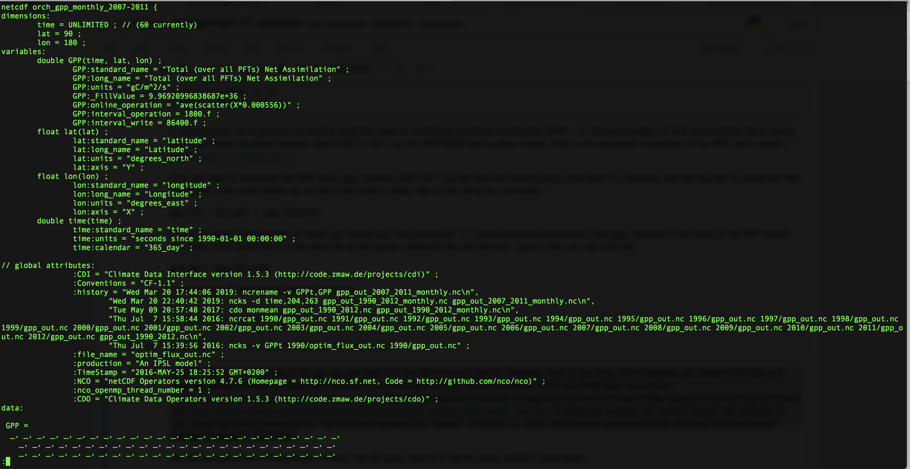
netCDF files: NCO commands using Unix/Linux

Slide 8
netCDF files
We will not use either of these today; instead, we will query what is in the file using python’s netCDF4 library.
You can find more information here: http://unidata.github.io/netcdf4-python/ .
It has been loaded onto these computers, but you can use typical Python package managers such as pip (https://pypi.org/project/netCDF4/ ) and anaconda (https://anaconda.org/anaconda/netcdf4 ) to install it on your own computers.

Slide 9
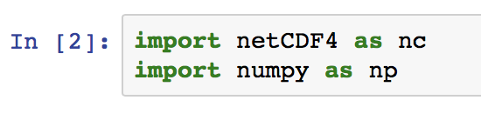
Importing netCDF4

Slide 10

Opening a netcdf file
Before we can extract data from the netcdf file, we need to open it. The netCDF4 library command for doing this is:
f=nc.Dataset(infile,'r’)
'r' means we're reading from the file, as opposed to writing to it.
Note that the variable name we read the file into can be anything we choose - here we use "f".

Slide 11
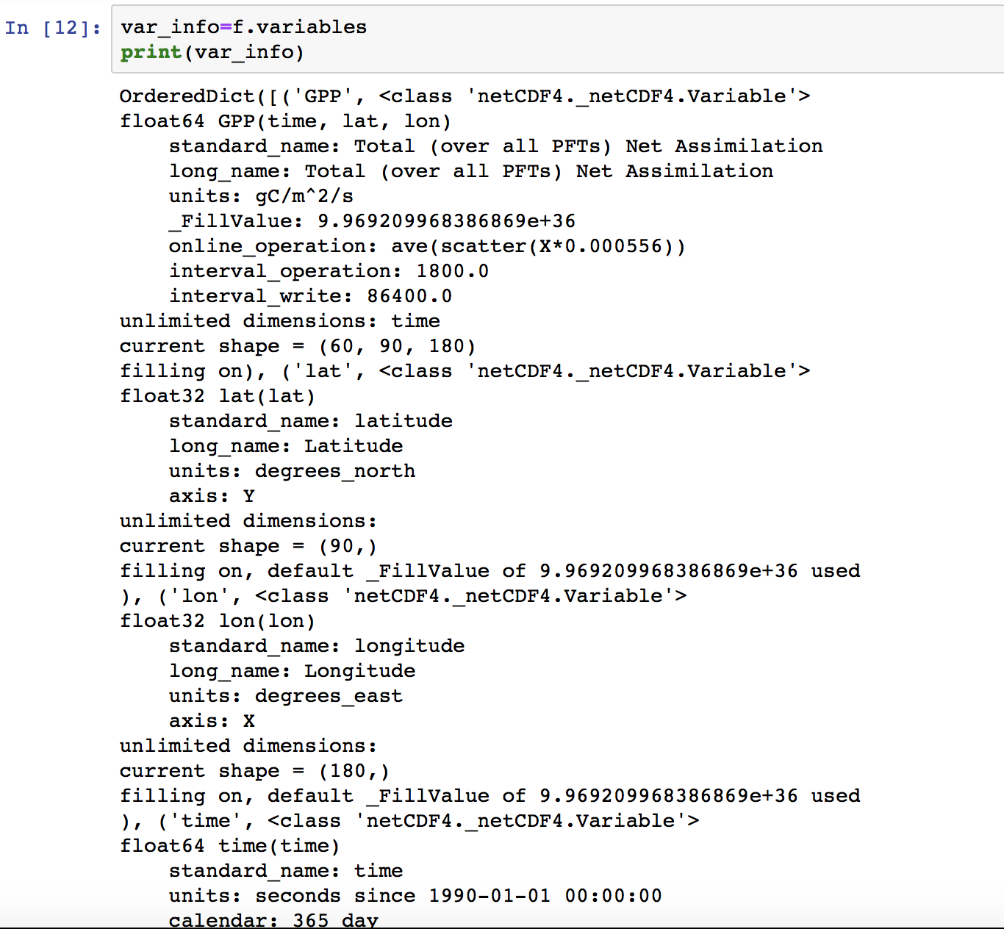
Querying information from the file
Now we have opened the file into the variable “f”, we can use that to query information in the file.
For example, if we want to find out which variables in the file we use the code:
var_info=f.variables
The information includes the data type for each variable (e.g. GPP is an array of floats), the dimension names for each variable and the size of each dimension.
The dimension names are given in brackets after the name of the variable.

Slide 12
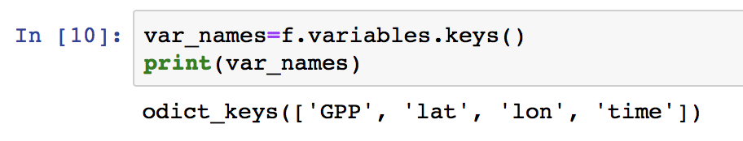
Querying information from the file
f.variables gives us an “ordered dictionary”…which is a specific Python structure
A simple way to find out what main items are in the dictionary is to use:
var_names=f.variables.keys()
We can then print var_names to see which variables are in the file.

Slide 13
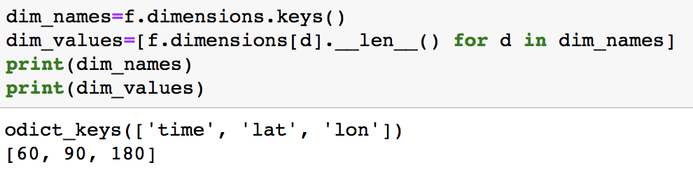
Querying information from the file
We can find out the information on the dimensions from printing out all the information on the variables.
But what if we just wanted to know which dimensions were included in the netcdf file and the value (size) of each dimension?
We do this using the following commands:
dim_names=f.dimensions.keys()

Slide 14
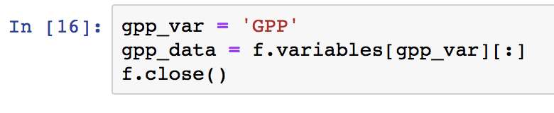
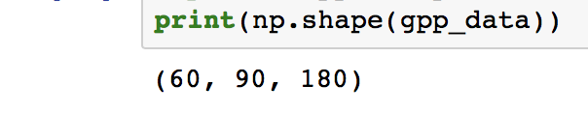
Loading data into an array
Now we want to extract the GPP data itself. We do this using the following commands:
data=f.variables[var][:]
where "var" is a string for the variable you want to extract.
For example, to extract GPP we can set gpp_var = 'GPP' and then use gpp_data = gpp_f.variables[gpp_var][:].
Once you have read in the data you can close the files we have opened using the command: f.close()
Netcdf data is read into a numpy array

Slide 15
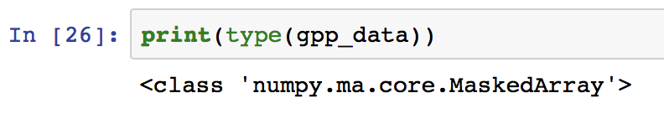
NumPy masked arrays
If we use the type() function, the output information shows us that this is a NumPy "Masked Array".
NumPy masked array module provides a set of functions that mask data points in array that correspond to missing values.
The netCDF4 python library reads the "_FillValue" attribute information and then stores the array as a masked array which masks all grid cells corresponding to the fill value of 9.969209968386869e+36
In this case, these missing values are the ocean values.

Slide 16
What does a masked array look like when we print out the data?
We know that the top left corner of the map is an ocean pixel, therefore we can see what this masked array looks like if we index the array for that pixel.
The gpp array dimensions are (time, lat, lon) – it is a 3d array
Indexing any element of the GPP array therefore requires 3 numbers (or colons) in square brackets:
gpp_data[time, lat, lon]
"lat" and "lon" correspond to the rows and columns of the data (last 2 dimensions of the index).
Therefore, the first dimension of the index is time.
gpp_data[0,0,0] corresponds to the first time step (January 2007) for the 1st row and the 1st column (i.e. the top left hand corner of the array).

Slide 17
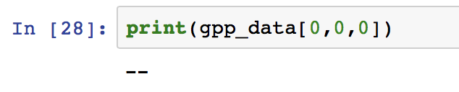
What does a masked array look like when we print out the data?
When you print out this result, it prints a "--". This -- shows that this grid cell is masked. I.e. the value of that grid cell corresponds to the fill value of 9.969209968386869e+36.
netCDF4 has read this into a masked array and masks all the grid cells corresponding to that value (i.e. all the ocean grid cells).
(Matplotlib also reads these masked values and prints them as white instead of a colored value.)
More information on Masked Arrays can be found here: https://docs.scipy.org/doc/numpy/reference/maskedarray.html .
There are many different NumPy masked array operations (https://docs.scipy.org/doc/numpy-1.13.0/reference/routines.ma.html )

Slide 18
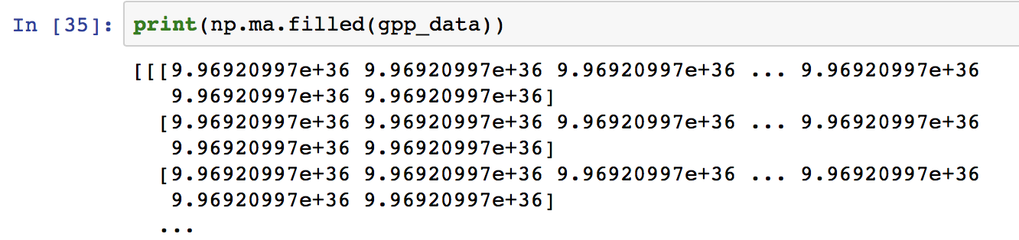
Filling in missing values
If you want to fill the missing (masked) values of the array we can use the command:
np.ma.filled(data, fill_value=None)
This replaces all of the masked grid cells with a missing value specified by the fill_value kwarg.
You can specify the missing value to be anything you want - it doesn't have to be the original missing value in the data.
“fill_value” is a keyword argument – i.e. it is optional, so you don't have to specify the fill_value. If you don’t, it will use the FillValue attribute in the netCDF file. E.g.:

Slide 19
Today’s homework
Two DataCamp tutorials (not graded)
See Canvas for more details

